Slide 1


Uncovering Insights into Cosmetics Safety Through Data Analysis

Slide 2
Data Description
Objective:
Dataset:
Purpose:
Analyse the hazardous chemicals reported in cosmetics sold in California (Source: California Safe Cosmetics Program (CSCP)).
Provide actionable insights on trends and safety awareness.
Chemical Dataset: Includes information on chemicals and their reporting details.
Categories Dataset: Describes product categories and their subcategories.
Enhance consumer safety awareness.
Facilitate regulatory compliance.

Slide 3
Importance of Hazardous Chemical Analysis
Public Health: Highlights risks associated with daily-use products.
Regulations: Helps policymakers enforce safety standards.
Consumer Awareness: Promotes informed purchasing decisions.
Brand Accountability: Identifies companies that heavily use harmful substances.
Notes:
Why chemicals in cosmetics??
Discuss the prevalence of cosmetics in daily life(linked to cancer, birth defects, or reproductive harm).
Explain the risks associated with hazardous chemicals and the role of regulations in mitigating these risks.
Highlight the importance of understanding hazardous chemicals in cosmetics for public safety.

Slide 4
Analysis Pipeline and Key Discoveries
Data Cleaning and Transformation:
Handled missing values using median and placeholder strategies.
Merged chemicals data with categories for a comprehensive dataset.
Removed duplicate entries for accuracy.
Calculated chemical counts per category for detailed insights.
Key Findings:
Certain categories, such as "Hair Products" and "Skincare," have higher chemical counts.
Top 10 companies significantly contribute to chemical usage.
Reporting trends reflect increased awareness and improved regulatory compliance.
Notes:
Addressed missing values, merged datasets, and removed duplicates for accuracy.
Identified higher chemical counts in "Hair Products" and "Skincare”
Top 10 companies contribute significantly, with trends showing improved compliance.

Slide 5
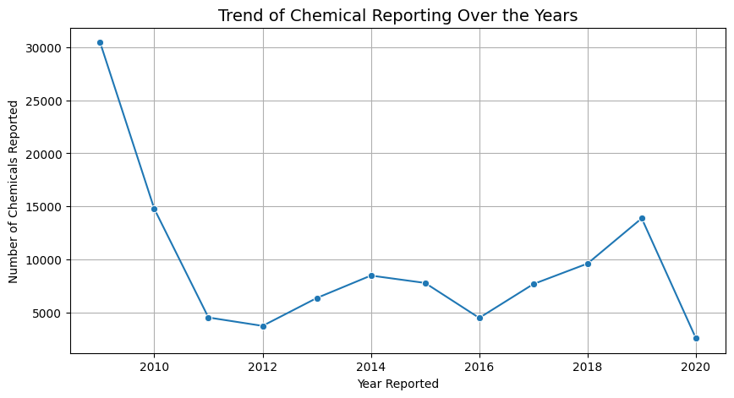
Trend Analysis
Line Plot of hazardous chemicals reporting over the years.
Increase in reporting post-2010, indicating heightened awareness or stricter regulations.
Notes:
Line Plot showing annual fluctuations in hazardous chemical reports
The observations made here is that the Step decline in reporting after 2010 and Relatively steady trends with occasional peaks in subsequent years
Peaks may signify the Increased regulatory enforcement and Greater awareness of chemical hazards
Reflects the dynamics of chemical reporting and compliance efforts over time.

Slide 6
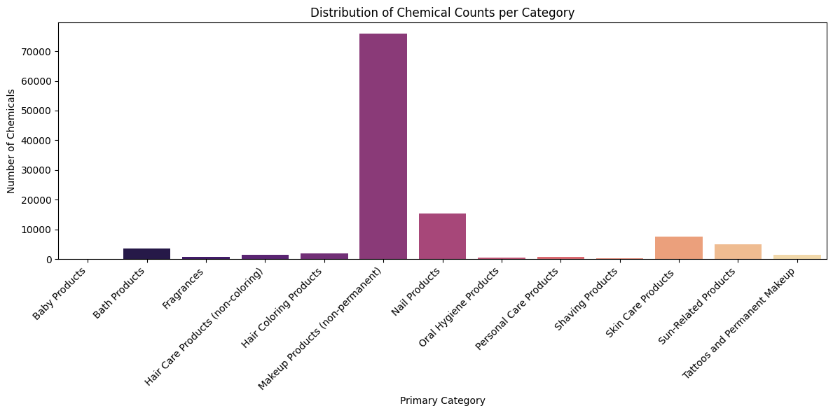
Chemical Distribution Across Categories
Bar Plot of chemical counts by primary category
Categories like “Hair Products” and “Skincare” have higher chemical counts, indicating they may pose greater risks.
Notes:
Bar plot illustrating hazardous chemical distribution across product categories
Observation here shows : Nail products show the highest chemical counts , Followed by Skin Care Products and Sun-Related Products.
Categories with higher chemical counts may pose greater risks and need for focused regulatory measures and consumer awareness

Slide 7
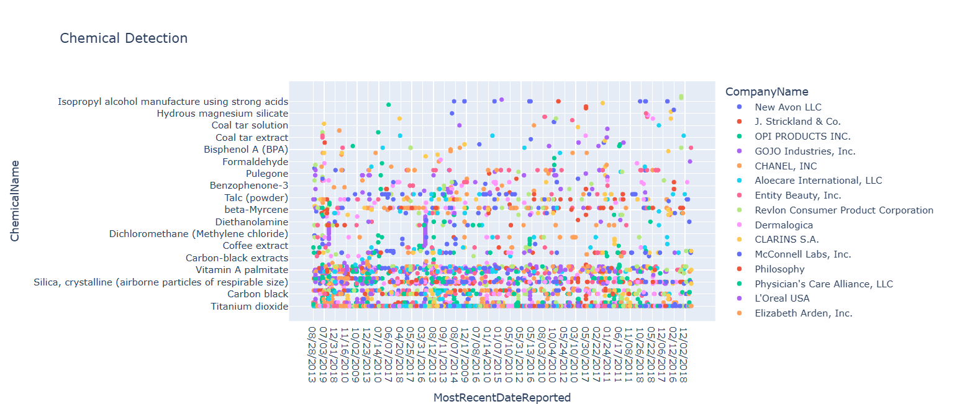
Chemical Detection by Company
The Scatter plot highlights the detection and reporting of various chemicals by different companies over time
Understanding these trends can help identify key timeframes and companies significantly contributing to chemical reporting
Notes:
Scatter Plot visualizing the reporting of chemicals by companies over time
Each dot represents a chemical reported by a company on a specific date
Clusters indicate periods of heightened reporting, possibly due to : Regulatory changes and Industry Trends

Slide 8
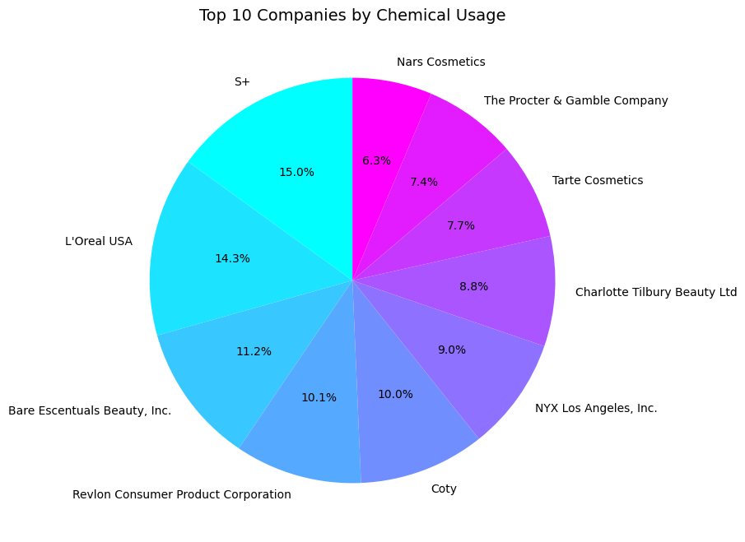
Top 10 Companies by Chemicals Usage
Pie chart of companies contributing to hazardous chemical usage.
A few companies dominate the share, necessitating targeted oversight.
Notes:
Highlights the largest contributors to hazardous chemical usage.
Companies like S+ (15%) and L’Oréal USA (14.3%) dominate the list.
Emphasizes the need for regulatory focus on key players in the industry.

Slide 9
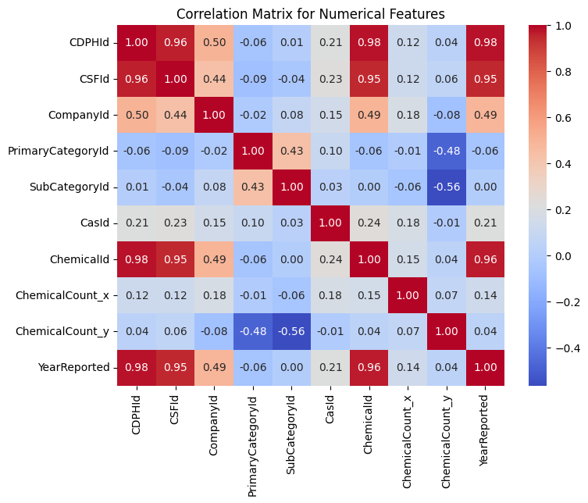
Correlation Analysis
Heatmap showing correlations between numerical features.
Relationships, such as between chemical count and reporting dates may exist the strong correlation.
Notes:
Shows relationships between numerical features in the dataset.
Strong positive correlations between ‘ChemicalId’ and ‘YearReported’.
Helps identify reporting patterns and dependencies within the data.

Slide 10
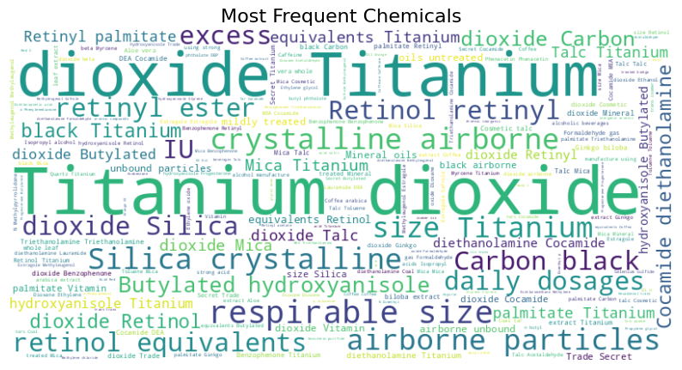
Word Cloud of Common Chemicals
Word cloud of most frequently reported chemicals.
Larger words indicate higher frequency, highlighting critical chemicals of concern.
Notes:
"Titanium Dioxide" and "Silica" are highly prevalent, indicating their frequent use in products.
Highlights the importance of awareness and regulation around these substances.

Slide 11


Challenges in Data Analysis
Dataset-Specified Challenges:
Large Dataset: Required efficient preprocessing and cleaning.
Missing Data: Addressed with median imputation for numerical data and placeholders for categorical data.
Code Challenges:
Applied statistical strategies for cleaning data
Structing readable, reusable code, Ensuring meaningful for cleaning data.
Managing Git history effectively for version control.

Slide 12



Tracking Progress with Git
Utilized Git for efficient version control and collaborative management of the "Chemicals in Cosmetics" project repository.
Organized workflow into logical commits for clear tracking of project stages and updates.
Key Git commands and operations included:
Cloning the repository: git clone.
Adding and committing changes: git add --all & git commit.
Pushing updates to GitHub: git push origin master
Notes:
Git was an essential tool for version control throughout this project. It helped me to manage updates and ensured collaboration was seamless
The structure of the workflow with logical commits, which made it easy to track each stage of the project and understanding what changes were made over time
Using Git, we were able to maintain project integrity, track process effectively, and collaborate smoothly

Slide 13
References
Source: California Safe Cosmetics Program (CSCP).
Publisher: California Department of Public Health (CDPH).
Tool: Google Colab (Python)

Slide 14

Thank You

